Slide 1
Real Time Advertisement Targeting
&
Embedding in Website
By
Rohit Vaidya & Farahnaj Inamdar
Dept Of Information Technology K.K.Wagh I.E.E.R

Slide 2
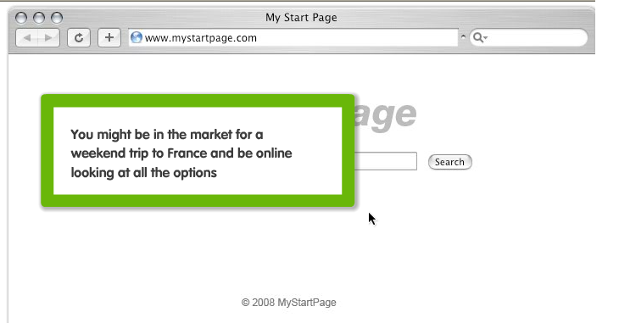
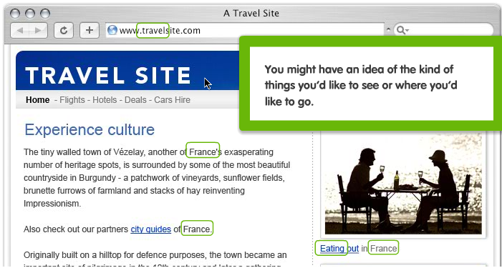
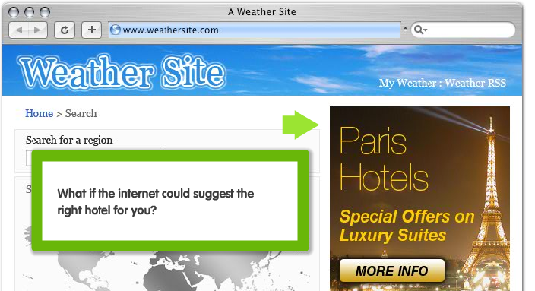
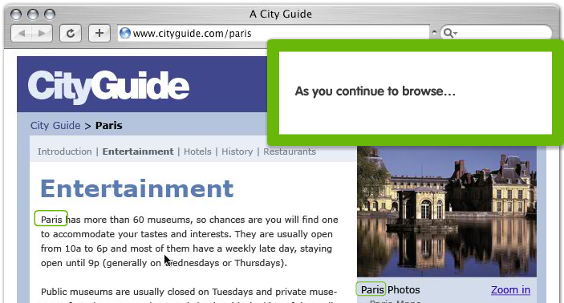
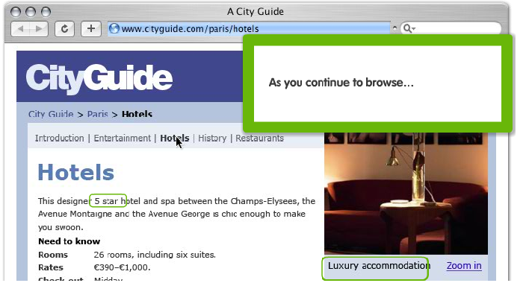

Slide 3
Introduction
Online Advertising generates lots of revenue which funds websites.
Search Engines and publishers gets the share of this business.
What about those who carry this traffic……..?????
The ISP’s ,ILECs, CLECs.

Slide 4
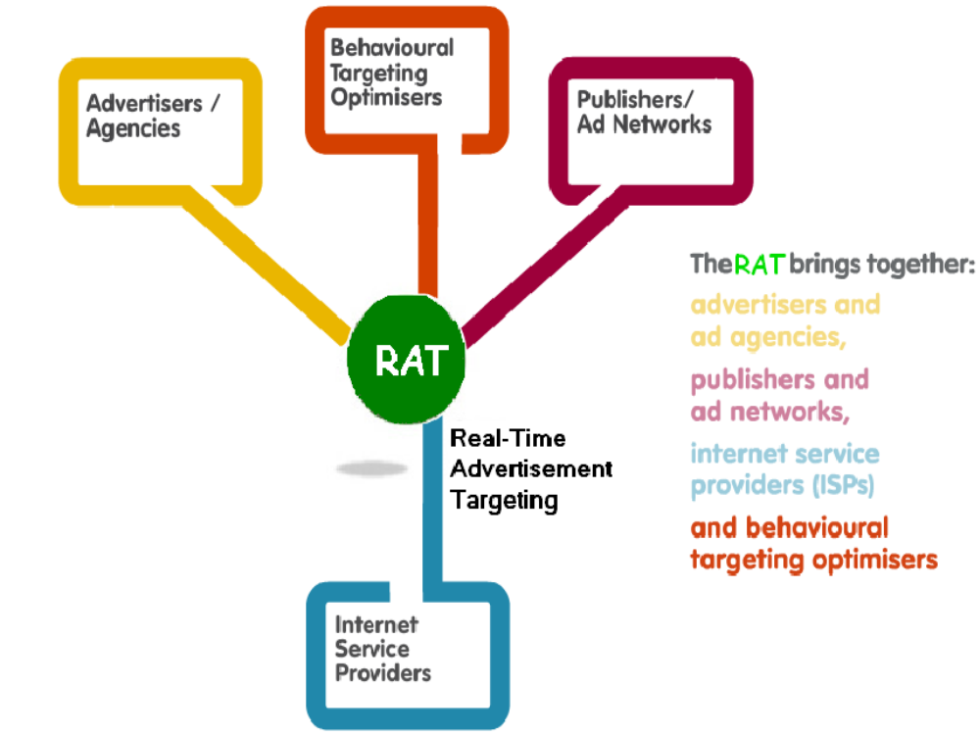
RAT Overview

Slide 5
Features of RAT
Based on User Based Model instead of Page Based Model for Advertising.
User gets behaviorally relevant advertisements.
Ability to create user channels for advertisements.

Slide 6
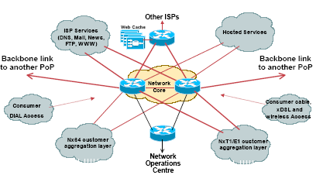
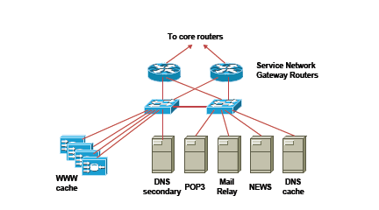
ISP Network.

Slide 7
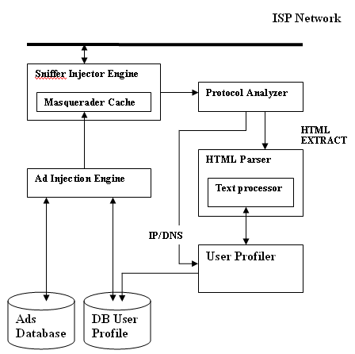
RAT Architecture

Slide 8
Data Structure at User Profiler
User Id | IP | Dns Query | Dns Response
1 | 59.95.56.69 | Rediff.com | ?
User Id | IP | Dns Query | Dns Response
1 | 59.95.56.69 | Rediff.com | 204.2.177.16

Slide 9
Architecture of Sniffer Injector Logic
Ethernet Interface
Decide
Action
6
5
Inject packets
Send output of decision
Sniff packets
3
Send inputs
4
Injector
Sniffer
Create Injector thread
Main()
Create Sniffer thread
2
1

Slide 10
Architecture of a Proactive Security Tool
Multi threaded programming
Create sniffer thread
Create injector thread
Sniff packets from the network
Send inputs to the decision module
Send output of decision to injector
Inject packets
Goto step 3:

Slide 11
Architecture of a Proactive Security Tool
Raw Sockets
Create sniffer thread
Create injector thread
Sniff packets from the network
Send inputs to the decision module
Send output of decision to injector
Inject packets
Goto step 3:

Slide 12
Architecture of a Proactive Security Tool
IPC – message queues
Create sniffer thread
Create injector thread
Sniff packets from the network
Send inputs to the decision module
Send output of decision to injector
Inject packets
Goto step 3:

Slide 13
Advantage over Search Engines
User Information is Stored for long which consumes resources
Ad is contextual.
Security concerns for malicious disclosure of information
Information is stored for a very short period of time.
Every Ad is Personalized.
Data Incinerator destroys every thing.

Slide 14
Future Enhancements
The parallelism involved in this system can be exploited with the use of massive parallel processors.

Slide 15
Conclusion

Slide 16



